Slide 1

BIG DATA APPLICATIONS IN MODERN FARMING
Subject: Big Data Analytics
Submitted by: Ankit Singh (Roll No: 24MBMA23) Course: MBA ( Gen.)
Department: School of Management Studies, University of Hyderabad
01

Slide 2
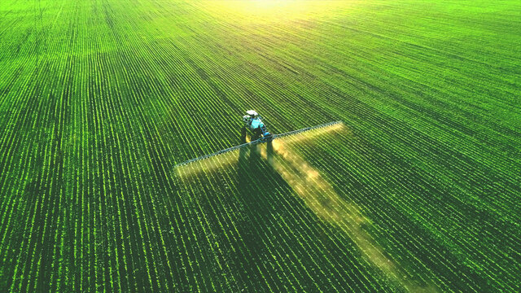
Introduction & Problem Statement
Introduction:
Agriculture is highly affected by market price volatility, pest outbreaks, and climatic changes.
Big Data Analytics enables large-scale processing and real-time sentiment tracking.
Digital Data from farmers and online platforms helps track their challenges
Problem Statement:
Lack of real-time systems for monitoring market trends and farmer sentiment.
No automated detection for pest or disease outbreaks.
Need for predictive analytics in agricultural forecasting.
02

Slide 3


Project Objectives & Use Cases Overview
Objectives:
Develop a Big Data pipeline using PySpark and Databricks.
Perform sentiment analysis on agricultural social media data.
Build ML models for price prediction and market demand.
Generate regional pest and sentiment alerts.
Identified Use Cases:
Pest and Disease Warning for farmers
Real-Time Crop Price Predictions
Checking Farmers’ Sentiment
Predicting Market Demand
Local Farming Alerts and Updates
03

Slide 4
Big Data Use Cases & Methods Applied
Use Case
1. Pest Detection
2. Price Nowcasting
3. Sentiment Monitoring
4. Market Demand Prediction
5. Regional Alerts
Goal
Identify pest/disease outbreaks from posts.
Predict near-term price trends.
Track regional farmer sentiment. Cluster regions by demand.
Generate actionable insights.
Big Data Technique Used
PySpark NLP + Rolling Z-Score RandomForestRegressor (MLlib) NLP + Polarity Analysis
K-Means Clustering
Rule-based PySpark Filters
Key Insight
Detected pest spikes by region. Positive sentiment = Price increase. Regional optimism index visualized. 4 demand segments identified.
Automated regional alerts generated.
04

Slide 5
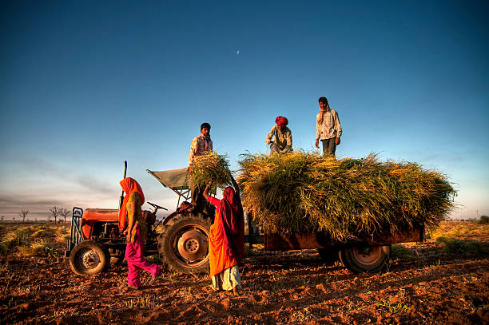

Big Data Analytics Approach
Tools & Technologies:
Databricks | PySpark | Spark MLlib | Power BI | Matplotlib
Pipeline Workflow:
Ingestion: Load data into Databricks workspace (CSV).
Transformation: Clean text, normalize timestamps, extract sentiment.
Feature Engineering: Derive pest_flag, avg_sentiment, z-score anomalies.
Model Training: Random Forest for price forecasting, K-Means for demand.
Alert Generation: Rule-based PySpark logic for pest and sentiment triggers.
05

Slide 6

Dataset Overview
Dataset: agri_big_data_3000.csv
Records: 3,000 rows
Attributes:
Region, Crop, Emotion, Post_Text, Date
Sentiment_Score, Price, Demand_Index, Temperature, Rainfall
Dataset Purpose: To simulate social media-driven agricultural data for analysis and forecasting.
Insight Example:
Positive sentiment posts corresponded with higher predicted prices.
06

Slide 7
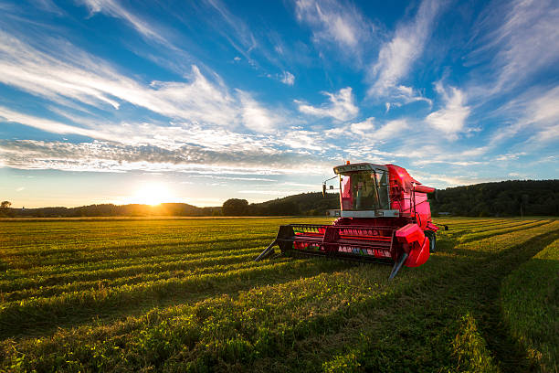
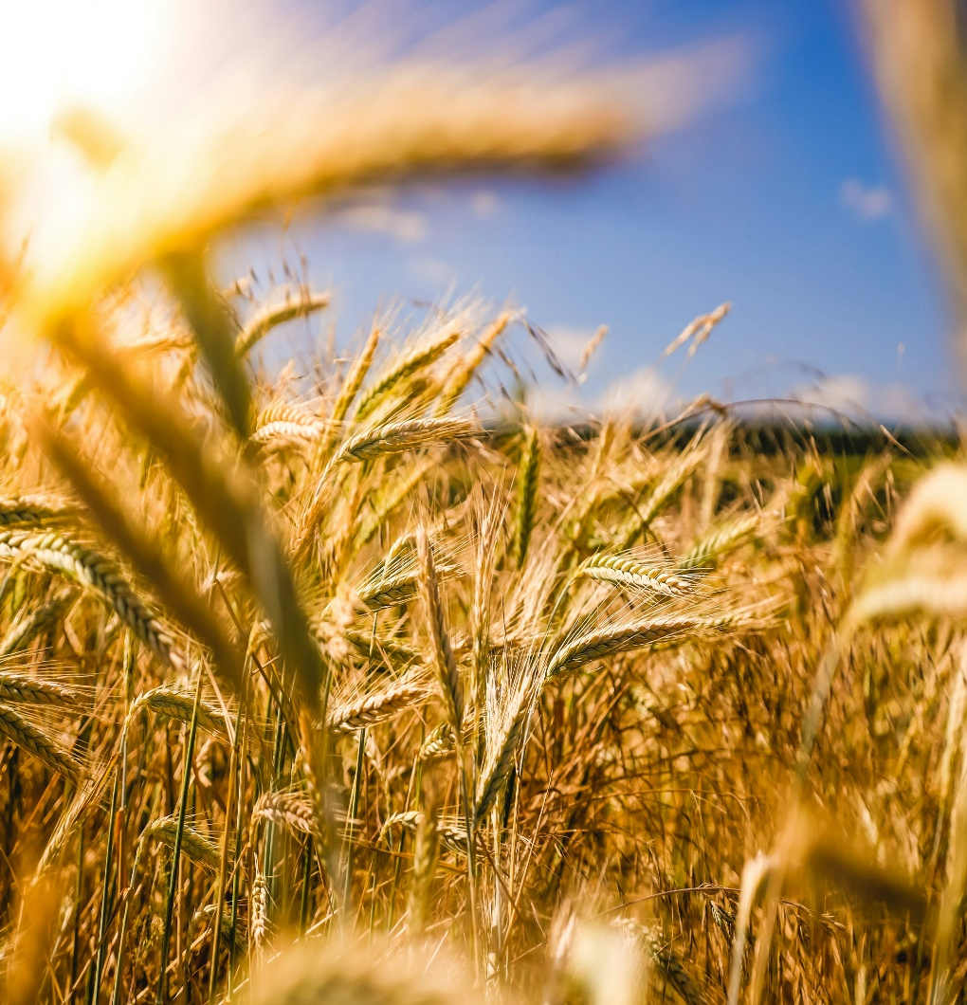
Results – Use Case-wise Outcomes
Use Case 1: Pest and Disease Warning for Farmers
PySpark text analysis identified pest-related keywords.
Rolling Z-Score anomaly detection flagged 4 regional pest spikes (z > 1.0).
Alerts generated for affected regions with recommendations for pest control measures.
Use Case 2: Real-Time Crop Price Predictions
RandomForestRegressor trained using avg_sentiment, post_count, and avg_demand. Achieved MSE ≈ 0.03 (high accuracy).
Positive sentiment posts were associated with next-day price increases.
Use Case 3: Checking Farmers’ Sentiment
Sentiment polarity derived via NLP (positive/neutral/negative).
Region-wise average sentiment visualised; southern regions showed higher optimism. Sentiment directly influenced demand and price patterns.
Use Case 4: Predicting Market Demand
K-Means (k=4) segmented regions based on sentiment, demand, and price.
Identified 4 distinct demand clusters: High, Moderate, Emerging, and Low demand zones. Clusters aligned with regional sentiment and rainfall data.
Use Case 5: Local Farming Alerts and Updates
Integrated pest, sentiment, and demand data. Rule-based PySpark conditions triggered alerts: Pest Spike → Deploy pest management.
Low Sentiment → Farmer awareness campaigns. Provided actionable insights to stakeholders.
07

Slide 8
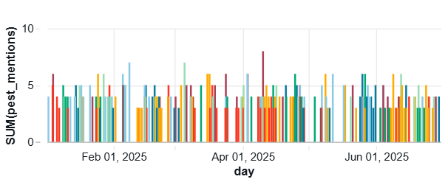
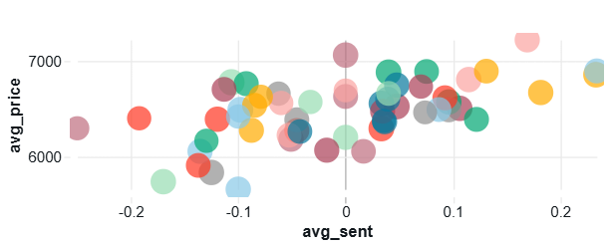
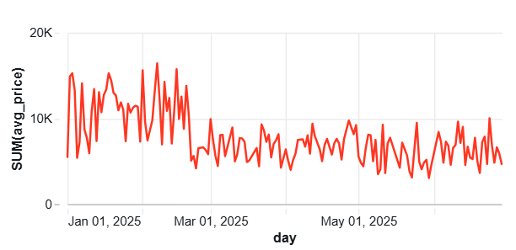
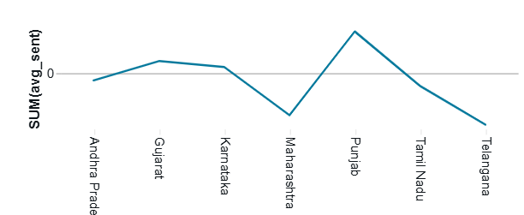
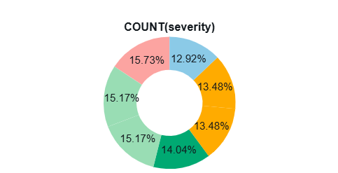
DASHBOARD
Alfredo Torres
Adora M
riguez
08

Slide 9


Conclusion & Deliverables
Conclusion:
Successfully built a Big Data Analytics pipeline using Databricks.
Automated the full process: ingestion → ML → alerts.
Enabled actionable agricultural insights via data-driven forecasting.
Deliverables:
5 Databricks Notebooks. Master Pipeline Script.
agri_big_data_3000.csv Dataset. Final Report and PPT.
09

Slide 10

Thank You
10

